Slide 1
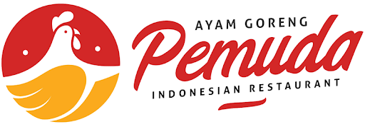
OPENING A NEW INDONESIAN RESTAURANT IN TORONTO, CANADA
Ozi Priawadi

Slide 2
IBM CAPSTONE FINAL
IBM DATA SCIENCE

Slide 3
TABLE OF CONTENT
Business Problem
Target Audience
Data
Methodology
Results
Discussion
Recommendations
Conclusion

Slide 4
BUSINESS PROBLEM
The objective of this capstone project is to find the most suitable Location for Entrepreneur to open a new Indonesian Restaurant in Toronto, Canada. By using Data Science and Machine Learning methods such as Clustering. This project aims to provide solutions to answer the business question: In Toronto, if an investor, entrepreneur, or chefs wants to open an Indonesian Restaurant, where should they consider opening it?

Slide 5
TARGET AUDIENCE
Investors, Entrepreneurs, or Chefs who interested to open a new restaurant and may need a piece of objective advice regarding the right location would be most successful to Open Indonesian Restaurant in Toronto, Canada.

Slide 6
DATA
To solve the problem, we will need data below:
List of Neighborhoods in Toronto, Canada.
Latitude and Longitude of these Neighborhoods.
Venue data related to Asian restaurants.

Slide 7
METHODOLOGY

Slide 8
METHODOLOGY
Step 1. Collecting Data from Wikipedia
Step 2. Use the Geopy and Folium libraries to get the coordinates of all locations and map geospatial data on a London map.
Step 3. Using Foursquare API, collect the top 100 restaurants and their categories for each location within a 500 meter radius.
Step 4. Group collected restaurants by location and by taking the mean of the frequency of occurrence of each type, preparing them for clustering.
Step 5. Cluster restaurants by k-means algorithm.
Step 6. Visualize clusters on the map, thus showing the best locations for opening the new Indonesian Restaurant.

Slide 9
RESULTS

Slide 10
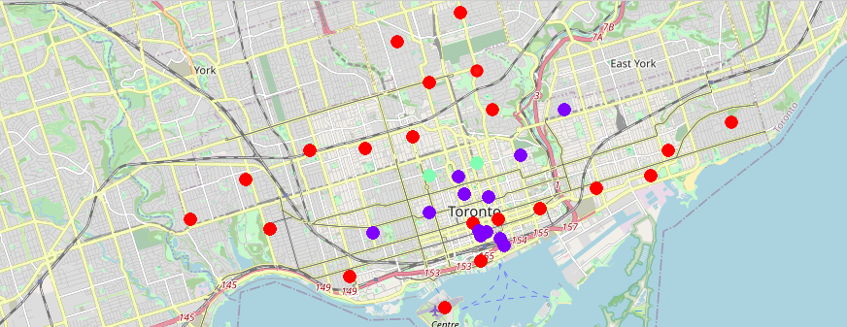
RESULTS
MAP LEGEND
Cluster 0 - Red dots
Cluster 1 - Purple dots
Cluster 2 - Light Green dots
The results from K-Means clustering show that we can categorize Toronto neighborhoods into 3 clusters based on how many Japanese Restaurants are in each neighborhood:
Cluster 0: Neighborhoods with lowest number to no existence of Japanese Restaurant
Cluster 1: Neighborhoods with high number of Japanese Restaurants
Cluster 2: Neighborhoods with high number of Japanese restaurants

Slide 11
DISCUSSION
•Most of Japanese Restaurant are concentrated in the Garden District, Ryerson
•Highest number of Japanese Restaurant can be found in Cluster 1 and Cluster 2
•Cluster 0 has very low number to no existence of Japanese Restaurant
•Cluster 0 mostly comes from Harbourfront East / Union Station and The Annex / North Midtown / Yorkville

Slide 12
RECOMMENDATIONS
•Open New Indonesian Restaurant in Cluster 0 with lowest number to no existence competition
•Avoid Neighborhood in Cluster 1 and 2, already high concentration of Japanese Restaurant and Intense Competition
•Nonetheless, if the food is authentic, affordable and good taste, I am confident that it will have great following everywhere

Slide 13
CONCLUSION
•Answer the business question: The neighborhoods in Cluster 0 are the most preferred locations to open New Indonesian Restaurant
•Findings of this project will help the relevant stakeholders (example: Investors, Entrepreneurs, or Chefs) to capitalize on the opportunities on High Potential Locations while avoiding overcrowded areas in their decisions to Open New Indonesian Restaurant
•In this project, we have gone through the process of identifying the business problem, specifying the data required, extracting and preparing the data, performing the machine learning by utilizing k-means clustering and providing recommendation to the stakeholder.

Slide 14
THANK YOU!
Ozi Priawadi
Email:
ozi.priawadi@gmail.com
IBM CAPSTONE PROJECT

